Slide 1
Java Script

Slide 2
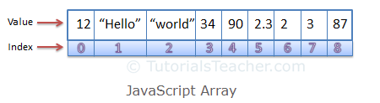


Array
An array is an object that can store a collection of items. Arrays become really useful when you need to store large amounts of data of the same type.
Suppose you want to store details of 500 employees. If you are using variables, you will have to create 500 variables whereas you can do the same with a single array.
You can access the items in an array by referring to its index number and the index of the first element of an array is zero
Spaces and line breaks are not important. A declaration can span multiple lines

Slide 3
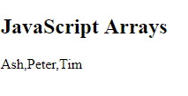
<!DOCTYPE html>
<html>
<body>
<h2>JavaScript Arrays</h2>
<p id="demo"></p>
<script>
var student = [
"Ash",
"Peter",
"Tim"
];
document.getElementById("demo").innerHTML = student;
</script>
</body>
</html>

Slide 4
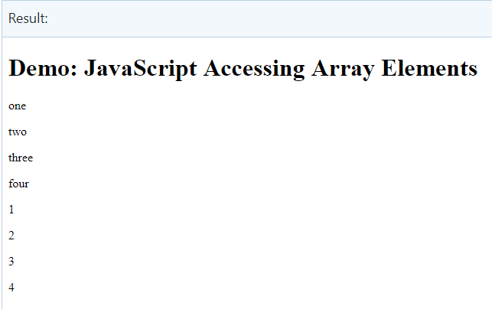
<!DOCTYPE html>
<html>
<body>
<h1>Demo: JavaScript Accessing Array Elements</h1>
<p id="p1"></p>
<p id="p2"></p>
<p id="p3"></p>
<p id="p4"></p>
<p id="p5"></p>
<p id="p6"></p>
<p id="p7"></p>
<p id="p8"></p>
<p id="p9"></p>
<script>
var stringArray = new Array("one", "two", "three", "four");
document.getElementById("p1").innerHTML = stringArray[0];
document.getElementById("p2").innerHTML = stringArray[1];
document.getElementById("p3").innerHTML = stringArray[2];
document.getElementById("p4").innerHTML = stringArray[3];
var numericArray = [1, 2, 3, 4];
document.getElementById("p5").innerHTML = numericArray[0];
document.getElementById("p6").innerHTML = numericArray[1];
document.getElementById("p7").innerHTML = numericArray[2];
document.getElementById("p8").innerHTML = numericArray[3];
</script>
</body>
</html>

Slide 5
Access the Full Array
var cars = ["Saab", "Volvo", "BMW"]; document.getElementById("demo").innerHTML = cars;
using for Loop
var stringArray = new Array("one", "two", "three", "four");
for (var i = 0; i < stringArray.length ; i++)
{
document.getElementById(“id" + i).innerHTML = stringArray[i];
}

Slide 6
JavaScript Array Methods & Property
The Array object has many properties and methods which help developers to handle arrays easily and efficiently. You can get the value of a property by specifying arrayname.property and the output of a method by specifying arrayname.method().
The constructor property returns an array's constructor function
var fruits = ["Banana", "Orange", "Apple", "Mango"]; fruits.constructor;
The length property sets or returns the number of elements in an array.
var fruits = ["Banana", "Orange", "Apple", "Mango"]; fruits.length;

Slide 7
The JavaScript method toString() converts an array to a string of (comma separated) array values.
The join() method also joins all array elements into a string.It behaves just like toString(), but in addition you can specify the separator:
The pop() method removes the last element from an array: fruits.pop() and var x = fruits.pop(); returns the value that was "popped out“
The push() method adds a new element to an array (at the end) and fruits.push("Kiwi") and var x = fruits.push("Kiwi"); returns the new array length:
Shift() removes the first array element and "shifts" all other elements to a lower index and returns the string that was "shifted out“
Unshift() method adds a new element to an array (at the beginning), and "unshifts" older elements and returns the new array length

Slide 8
Sort () method sorts an array alphabetically:
Reverse() method reverses the elements in an array. (use after sort)
The compare function is to define an alternative sort order. The compare function should return a negative, zero, or positive value, depending on the arguments: function(a, b){return a - b}
If the result is negative a is sorted before b.
If the result is positive b is sorted before a.
If the result is 0 no changes is done with the sort order of the two values.
Lets practice https://www.w3schools.com/js/js_array_sort.asp

Slide 9
Practice
Methods
https://www.w3schools.com/js/js_array_methods.asp
Sort
https://www.w3schools.com/js/js_array_sort.asp

Slide 10
Activity
Create an array of student Name (min 5 names)
Get the number how many students in array using length property
Sort the array
Reverse the array
Use pop method
Use push method
Note remember to display an array after each method

Slide 11
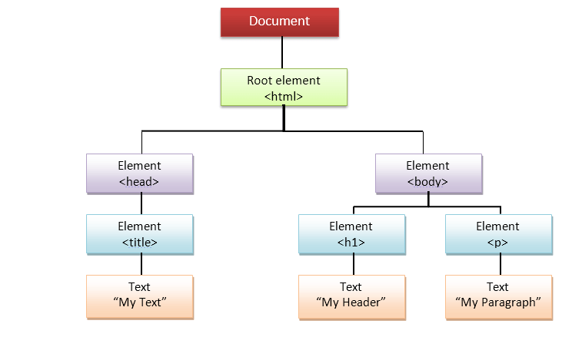
JavaScript DOM
JavaScript can access all the elements in a webpage making use of Document Object Model (DOM). In fact, the web browser creates a DOM of the webpage when the page is loaded. The DOM model is created as a tree of objects like this:

Slide 12
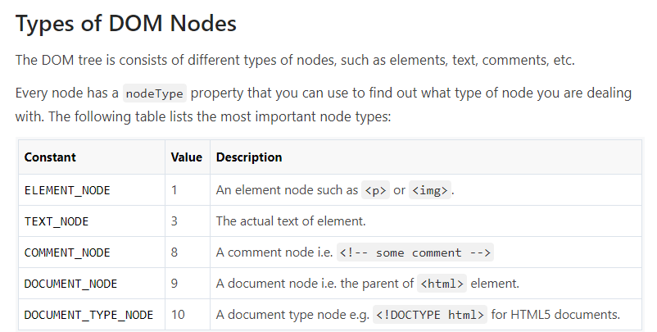

Slide 13
With the object model, JavaScript gets all the power it needs to create dynamic HTML:
JavaScript can change all the HTML elements in the page
JavaScript can change all the HTML attributes in the page
JavaScript can change all the CSS styles in the page
JavaScript can remove existing HTML elements and attributes
JavaScript can add new HTML elements and attributes
JavaScript can react to all existing HTML events in the page
JavaScript can create new HTML events in the page
Note : Already covered
getElementById method used id="demo" to find the element.
The innerHTML property is useful for getting or replacing the content of HTML elements

Slide 14

Selecting the Topmost Elements
<!DOCTYPE html>
<html lang="en">
<head>
<meta charset="utf-8">
<title>JS Select Topmost Elements</title>
</head>
<body>
<script>
// Display lang attribute value of html element
alert(document.documentElement.getAttribute("lang")); // Outputs: en
// Set background color of body element
document.body.style.background = "yellow";
// Display tag name of the head element's first child
alert(document.head.firstElementChild.nodeName); // Outputs: meta
</script>
</body>
</html>
The topmost elements in an HTML document are available directly as document properties. For example, the <html> element can be accessed with document.documentElement property, whereas the <head> element can be accessed with document.head property, and the <body> element can be accessed with document.body property.
But, be careful. If document.body is used before the <body> tag (e.g. inside the <head>), it will return null instead of the body element.

Slide 15
Selecting Elements by ID
<!DOCTYPE html>
<html lang="en">
<head>
<meta charset="utf-8">
<title>JS Select Element by ID</title>
</head>
<body>
<p id="mark">This is a paragraph of text.</p>
<p>This is another paragraph of text.</p>
<script>
// Selecting element with id mark
var match = document.getElementById("mark");
// Highlighting element's background
match.style.background = "yellow";
</script>
</body>
</html>

Slide 16
getElementsByTagName
<html>
<head>
<title>DOM!!!</title>
</head>
<body>
<h1>Welcome</h1>
<p>This is the welcome message.</p>
<h2>Technology</h2>
<p id="second">This is the technology section.</p>
<script type="text/javascript">
var paragraphs = document.getElementsByTagName("p");
alert("Content in the second paragraph is " + paragraphs[1].innerHTML);
document.getElementById("second").innerHTML = "The orginal message is changed.";
</script>
</body>
</html>

Slide 17
Selecting Elements by Class Name

Slide 18
Selecting Elements with CSS Selectors

Slide 19
Styling DOM Elements in JavaScript
You can also apply style on HTML elements to change the visual presentation of HTML documents dynamically using JavaScript.
You can set almost all the styles for the elements like, fonts, colors, margins, borders, background images, text alignment, width and height, position, and so on.
Many CSS properties, such as font-size, background-image, text-decoration, etc. contain hyphens (-) in their names. Since, in JavaScript hyphen is a reserved operator and it is interpreted as a minus sign, so it is not possible to write an expression, like: elem.style.font-size
Therefore, in JavaScript, the CSS property names that contain one or more hyphens are converted to intercapitalized style word. It is done by removing the hyphens and capitalizing the letter immediately following each hyphen, thus the CSS property font-size becomes the DOM property fontSize, border-left-style becomes borderLeftStyle, and so on

Slide 20
<!DOCTYPE html>
<html lang="en">
<head>
<meta charset="utf-8">
<title>JavaScript Add Inline Styles to an Element</title>
</head>
<body>
<p id="intro">This is a paragraph.</p>
<p>This is another paragraph.</p>
<button type="button" onclick="setStyle()">Set intro paragraph styles</button>
<script>
function setStyle() {
// Selecting element
var elem = document.getElementById("intro");
// Appling styles on element
elem.style.color = "blue";
elem.style.fontSize = "18px";
elem.style.fontWeight = "bold";
}
</script>
</body>
</html>
Note : DOM styling not in detail

Slide 21
JavaScript DOM Get Set Attributes
<!DOCTYPE html>
<html lang="en">
<head>
<meta charset="utf-8">
<title>JavaScript Get the Value of an Attribute</title>
</head>
<body>
<p><a href="https://www.google.com/" target="_blank" id="myLink">Google</a></p>
<script>
// Selecting the element by ID attribute
var link = document.getElementById("myLink");
// Getting the attributes values
var href = link.getAttribute("href");
document.write(href); // Prints: https://www.google.com/
document.write("<br>");
var target = link.getAttribute("target");
document.write(target); // Prints: _blank
</script>
</body>
</html>
The attributes are special words used inside the start tag of an HTML element to control the tag's behaviour or provides additional information about the tag.
The getAttribute() method is used to get the current value of a attribute on the element.
If the specified attribute does not exist on the element, it will return null

Slide 22
Setting Attributes on Elements
<!DOCTYPE html>
<html lang="en">
<head>
<meta charset="utf-8">
<title>JavaScript Remove an Attribute from an Element</title>
</head>
<body>
<p><a href="https://www.google.com/" id="myLink">Google</a></p>
<script>
// Selecting the element
var link = document.getElementById("myLink");
// Removing the href attribute
link.setAttribute("href", "https://visioncollege.ac.nz/");
</script>
</body>
</html>
The setAttribute() method is used to set an attribute on the specified element
you can use the setAttribute() method to update or change the value of an existing attribute on an HTML element

Slide 23
Removing Attributes from Elements
<!DOCTYPE html>
<html lang="en">
<head>
<meta charset="utf-8">
<title>JavaScript Change the Value of an Attribute</title>
</head>
<body>
<p><a href="#" id="myLink">Tutorial Republic</a></p>
<script>
// Selecting the element
var link = document.getElementById("myLink");
// Changing the href attribute value
link.removeAttribute("href");
</script>
</body>
</html>
The removeAttribute() method is used to remove an attribute from the specified element.
The JavaScript code in the following example will remove the href attribute from an anchor element.

Slide 24
Manipulating DOM Elements in JavaScript
<div id="main">
<h1 id="title">Hello World!</h1>
<p id="hint">This is a simple paragraph.</p> </div>
<script>
// Creating a new div element var newDiv = document.createElement("div");
// Creating a text node
var newContent = document.createTextNode("Hi, how are you doing?");
// Adding the text node to the newly created div newDiv.appendChild(newContent);
// Adding the newly created element and its content into the DOM
var currentDiv = document.getElementById("main");
document.body.appendChild(newDiv, currentDiv);
</script>
Adding New Elements to DOM
You can explicitly create new element in an HTML document, using the document.createElement() method.
This method creates a new element, but it doesn't add it to the DOM; you'll have to do that in a separate step
The appendChild() method adds the new element at the end of any other children of a specified parent node.
However, if you want to add the new element at the beginning of any other children you can use the insertBefore() method

Slide 25
<!-- beforebegin -->
<div id="main">
<!-- afterbegin -->
<h1 id="title">Hello World!</h1>
<!-- beforeend -->
</div>
<!-- afterend -->
<script>
// Selecting target element
var mainDiv = document.getElementById("main");
// Inserting HTML just before the element itself, as a previous sibling
mainDiv.insertAdjacentHTML('beforebegin', '<p>This is paragraph one.</p>');
// Inserting HTML just inside the element, before its first child mainDiv.insertAdjacentHTML('afterbegin', '<p>This is paragraph two.</p>');
// Inserting HTML just inside the element, after its last child mainDiv.insertAdjacentHTML('beforeend', '<p>This is paragraph three.</p>');
// Inserting HTML just after the element itself, as a next sibling mainDiv.insertAdjacentHTML('afterend', '<p>This is paragraph four.</p>'); </script>
the innerHTML property replaces all existing content of an element. So if you want to insert the HTML into the document without replacing the existing contents of an element, you can use the insertAdjacentHTML() method.
This method accepts two parameters: the position in which to insert and the HTML text to insert. The position must be one of the following values: "beforebegin", "afterbegin", "beforeend", and "afterend". This method is supported in all major browsers.
The beforebegin and afterend positions work only if the node is in the DOM tree and has a parent element.

Slide 26
Removing Existing Elements from DOM
<div id="main">
<h1 id="title">Hello World!</h1>
<p id="hint">This is a simple paragraph.</p>
</div>
<script>
var parentElem = document.getElementById("main");
var childElem = document.getElementById("hint");
parentElem.removeChild(childElem);
</script>
It is also possible to remove the child element without exactly knowing the parent element. Simply find the child element and use the parentNode property to find its parent element. This property returns the parent of the specified node in the DOM tree.
<div id="main">
<h1 id="title">Hello World!</h1>
<p id="hint">This is a simple paragraph.</p>
</div>
<script>
var childElem = document.getElementById("hint");
childElem.parentNode.removeChild(childElem); </script

Slide 27
Replacing Existing Elements in DOM
You can also replace an element in HTML DOM with another using the replaceChild() method. This method accepts two parameters: the node to insert and the node to be replaced. It has the syntax like parentNode.replaceChild(newChild, oldChild);
<div id="main">
<h1 id="title">Hello World!</h1>
<p id="hint">This is a simple paragraph.</p>
</div>
<script>
var parentElem = document.getElementById("main");
var oldPara = document.getElementById("hint");
// Creating new elememt
var newPara = document.createElement("p");
var newContent = document.createTextNode("This is a new paragraph.");
newPara.appendChild(newContent);
// Replacing old paragraph with newly created paragraph parentElem.replaceChild(newPara, oldPara);
</script>

Slide 28
Navigating Between DOM Nodes
<body>
<div id="main">
<h1 id="title">My Heading</h1>
<p id="hint"><span>This is some text.</span></p>
</div>
<script>
var main = document.getElementById("main");
console.log(main.firstChild.nodeName); // Prints: #text
var hint = document.getElementById("hint");
console.log(hint.firstChild.nodeName); // Prints: SPAN
</script>
<p><strong>Note:</strong> Please check out the browser console by pressing the f12 key on the keyboard.</p>
</body>
Accessing the Child Nodes
You can use the firstChild and lastChild properties of the DOM node to access the first and last direct child node of a node, respectively. If the node doesn't have any child element, it returns null
The nodeName is a read-only property that returns the name of the current node as a string. For example, it returns the tag name for element node, #text for text node, #comment for comment node, #document for document node, and so on.

Slide 29
If the previous example, the nodeName of the first-child node of the main DIV element returns #text instead of H1. Because, whitespace such as spaces, tabs, newlines, etc. are valid characters and they form #text nodes and become a part of the DOM tree. Therefore, since the <div> tag contains a newline before the <h1> tag, so it will create a #text node.
To avoid the issue with firstChild and lastChild returning #text or #comment nodes, you could alternatively use the firstElementChild and lastElementChild properties to return only the first and last element node, respectively. But, it will not work in IE 9 and earlier.
<body>
<div id="main">
<h1 id="title">My Heading</h1>
<p id="hint"><span>This is some text.</span></p>
</div>
<script>
var main = document.getElementById("main");
console.log(main.firstElementChild.nodeName); // Prints: H1
main.firstElementChild.style.color = "red";
var hint = document.getElementById("hint");
console.log(hint.firstElementChild.nodeName); // Prints: SPAN
hint.firstElementChild.style.color = "blue";
</script>
<p><strong>Note:</strong> Please check out the browser console by pressing the f12 key on the keyboard.</p>
</body>

Slide 30
<div id="main">
<h1 id="title">My Heading</h1>
<p id="hint"><span>This is some text.</span></p>
</div>
<script>
var main = document.getElementById("main");
// First check that the element has child nodes
if(main.hasChildNodes()) {
var nodes = main.childNodes;
// Loop through node list and display node name
for(var i = 0; i < nodes.length; i++) {
alert(nodes[i].nodeName);
}
}
</script>
Similarly, you can use the childNodes property to access all child nodes of a given element, where the first child node is assigned index 0
The childNodes returns all child nodes, including non-element nodes like text and comment nodes. To get a collection of only elements, use children property instead
<script>
var main = document.getElementById("main");
// First check that the element has child nodes if(main.hasChildNodes()) {
var nodes = main.children;
// Loop through node list and display node name for(var i = 0; i < nodes.length; i++) { alert(nodes[i].nodeName);
}
}
</script>

Slide 31
Accessing the Parent Nodes
You can use the parentNode property to access the parent of the specified node in the DOM tree.
The parentNode will always return null for document node, since it doesn't have a parent.
The topmost DOM tree nodes can be accessed directly as document properties.
For example, the <html> element can be accessed with document.documentElement property, whereas the <head> element can be accessed with document.head property, and the <body> element can be accessed with document.body property
<div id="main">
<h1 id="title">My Heading</h1>
<p id="hint"><span>This is some text.</span></p>
</div>
<script>
var hint = document.getElementById("hint");
alert(hint.parentNode.nodeName); // Outputs: DIV
alert(document.documentElement.parentNode.nodeName); // Outputs: #document
alert(document.parentNode); // Outputs: null
</script>

Slide 32
Accessing the Sibling Nodes
You can use the previousSibling and nextSibling properties to access the previous and next node in the DOM tree, respectively
Alternatively, you can use the previousElementSibling and nextElementSibling to get the previous and next sibling element skipping any whitespace text nodes.
All these properties returns null if there is no such sibling.
<div id="main">
<h1 id="title">My Heading</h1>
<p id="hint"><span>This is some text.</span></p><hr>
</div>
<script>
var title = document.getElementById("title");
alert(title.previousSibling.nodeName); // Outputs: #text
var hint = document.getElementById("hint");
alert(hint.nextSibling.nodeName); // Outputs: HR
</script>

Slide 33
<div id="main">
<h1 id="title">My Heading</h1>
<p id="hint"><span>This is some text.</span></p>
</div>
<script>
var hint = document.getElementById("hint");
alert(hint.previousElementSibling.nodeName); // Outputs: H1
alert(hint.previousElementSibling.textContent); // Outputs: My Heading
var title = document.getElementById("title");
alert(title.nextElementSibling.nodeName); // Outputs: P
alert(title.nextElementSibling.textContent); // Outputs: This is some text.
</script>
The textContent property represents the text content of a node and all of its descendants

Slide 34
Revise and Practice DOM

Slide 35
BOM (Browser Object Model)
<!DOCTYPE html>
<html lang="en">
<head>
<meta charset="utf-8">
<title>JavaScript Get Browser Viewport Dimensions</title>
</head>
<body>
<script>
function windowSize(){
var w = window.innerWidth;
var h = window.innerHeight;
alert("Width: " + w + ", " + "Height: " + h);
}
</script>
<button type="button" onclick="windowSize();">Get Window Size</button>
</body>
</html>
The window object represents a window containing a DOM document. A window can be the main window, a frame set or individual frame, or even a new window created with JavaScript.
from the preceding chapters we've used the alert() method in our scripts to show popup messages. This is a method of the window object.
The window object provides the innerWidth and innerHeight property to find out the width and height of the browser window viewport (in pixels) including the horizontal and vertical scrollbar, if rendered.

Slide 36
However, if you want to find out the width and height of the window excluding the scrollbars you can use the clientWidth and clientHeight property of any DOM element
<!DOCTYPE html>
<html lang="en">
<head>
<meta charset="utf-8">
<title>JavaScript Get Width and Height of the Browser Viewport Excluding Scrollbars</title>
<style>
body{
min-height: 2000px;
}
</style>
</head>
<body>
<script>
function windowSize(){
var w = document.documentElement.clientWidth;
var h = document.documentElement.clientHeight;
alert("Width: " + w + ", " + "Height: " + h);
}
</script>
<button type="button" onclick="windowSize();">Get Window Size</button>
</body>
</html>

Slide 37
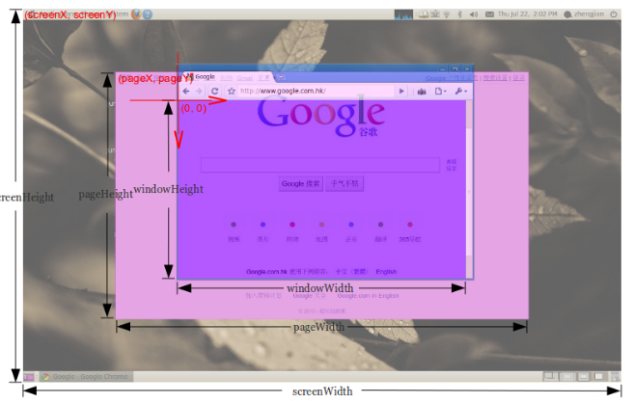
JavaScript Window Screen
<!DOCTYPE html>
<html lang="en">
<head>
<meta charset="utf-8">
<title>JavaScript Get Screen Resolution</title>
</head>
<body>
<script>
function getResolution() {
alert("Your screen is: " + screen.width + "x" + screen.height);
}
</script>
<button type="button" onclick="getResolution();">Get Resolution</button>
</body>
</html>
The window.screen object contains information about the user's screen such as resolution (i.e. width and height of the screen), color depth, pixel depth, etc.
pageHeight(on a pic) u can get with: document.body.scrollHeight
More info https://quirksmode.org/mobile/viewports.html

Slide 38
Getting Available Width and Height of the Screen
<!DOCTYPE html>
<html lang="en">
<head>
<meta charset="utf-8">
<title>JavaScript Get Available Width and Height of the Screen</title>
</head>
<body>
<script>
function getAvailSize() {
alert("Available Screen Width: " + screen.availWidth + ", Height: " + screen.availHeight);
}
</script>
<button type="button" onclick="getAvailSize();">Get Available Size</button>
</body>
</html>
The screen.availWidth and screen.availHeight property can be used to get the width and height available to the browser for its use on user's screen, in pixels.
The screen's available width and height is equal to screen's actual width and height minus width and height of interface features like the taskbar in Windows.

Slide 39
Getting Screen Color Depth
Color depth indicates how many colors a device screen is capable to produce. For example, screen with color depth of 8 can produce 256 colors (28).
Currently, most devices has screen with color depth of 24 or 32. In simple words more bits produce more color variations, like 24 bits can produce 224 = 16,777,216 color variations (true colors), whereas 32 bits can produce 232 = 4,294,967,296 color variations (deep colors).
As of now virtually every computer and phone display uses 24-bit color depth. 24 bits almost always uses 8 bits of each of R, G, B. Whereas in case of 32-bit color depth, 24 bits are used for the color, and the remaining 8 bits are used for transparency.
<!DOCTYPE html>
<html lang="en">
<head>
<meta charset="utf-8">
<title>JavaScript Get Color Depth of the Screen</title>
</head>
<body>
<script>
function getColorDepth() {
alert("Your screen color depth is: " + screen.colorDepth);
}
</script>
<button type="button" onclick="getColorDepth();">Get Color Depth</button>
</body>
</html>

Slide 40
Getting Screen Pixel Depth
<!DOCTYPE html>
<html lang="en">
<head>
<meta charset="utf-8">
<title>JavaScript Get Pixel Depth of the Screen</title>
</head>
<body>
<script>
function getPixelDepth() {
alert("Your screen pixel depth is: " + screen.pixelDepth);
}
</script>
<button type="button" onclick="getPixelDepth();">Get Pixel Depth</button>
</body>
</html>
Pixel depth is the number of bits used per pixel by the system display hardware.
For modern devices, color depth and pixel depth are equal.

Slide 41
The Location Object
<!DOCTYPE html>
<html lang="en">
<head>
<meta charset="utf-8">
<title>JavaScript Get Current URL</title>
</head>
<body>
<script>
function getURL() {
alert("The URL of this page is: " + window.location.href);
}
</script>
<button type="button" onclick="getURL();">Get Page URL</button>
</body>
</html

Slide 42
Getting Different Part of a URL Similarly, you can use other properties of the location object such as protocol, hostname, port, pathname, search, etc. to obtain different part of the URL.
// Prints complete URL
document.write(window.location.href);
// Prints protocol like http: or https: document.write(window.location.protocol);
// Prints hostname with port like localhost or localhost:3000 document.write(window.location.host);
// Prints hostname like localhost or www.example.com document.write(window.location.hostname);
// Prints port number like 3000
document.write(window.location.port);
// Prints pathname like /products/search.php document.write(window.location.pathname);
// Prints query string like ?q=ipad document.write(window.location.search);
// Prints fragment identifier like #featured document.write(window.location.hash);
When you visit a website, you're always connecting to a specific port (e.g. http://localhost:3000). However, most browsers will simply not display the default port numbers, for example, 80 for HTTP and 443 for HTTPS

Slide 43
Loading New Documents- assign() & replace()
<!DOCTYPE html>
<html lang="en">
<head>
<meta charset="utf-8">
<title>JavaScript Load another Resource from a URL</title>
</head>
<body>
<script>
function loadHomePage() {
window.location.assign("https://www.google.com/");
}
</script>
<button type="button" onclick="loadHomePage();">Load Home Page</button>
</body>
</html>
<!DOCTYPE html>
<html lang="en">
<head>
<meta charset="utf-8">
<title>JavaScript Replace Current URL with a New URL</title>
</head>
<body>
<script>
function loadHomePage(){
window.location.replace("https://www.google.com");
}
</script>
<button type="button" onclick="loadHomePage();">Load Home Page</button>
</body>
</html>
What’s the difference

Slide 44
Reloading the Page Dynamically
<!DOCTYPE html>
<html lang="en">
<head>
<meta charset="utf-8">
<title>JavaScript Reload a Page Dynamically</title>
</head>
<body>
<script>
function forceReload() {
window.location.reload(true);
}
</script>
<button type="button" onclick="forceReload();">Reload Page</button>
</body>
</html>
The reload() method can be used to reload the current page dynamically.
You can optionally specify a Boolean parameter true or false. If the parameter is true, the method will force the browser to reload the page from the server. If it is false or not specified, the browser may reload the page from its cache.
The result of calling reload() method is different from clicking browser's Reload/Refresh button.
The reload() method clears form control values that otherwise might be retained after clicking the Reload/Refresh button in some browsers.

Slide 45
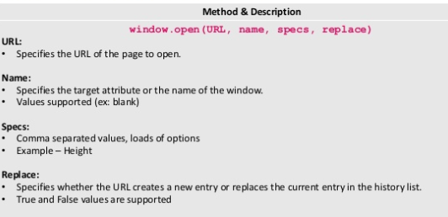
Open() (Refer to page 46 notes)
The open() method opens a new browser window, or a new tab, depending on your browser settings.
Use the close() method to close the window.

Slide 46
JavaScript Window History
<!DOCTYPE html>
<html lang="en">
<head>
<meta charset="utf-8">
<title>JavaScript Get History Length</title>
</head>
<body>
<script>
function getViews() {
alert("You've accessed " + history.length + " web pages in this session.");
}
</script>
<button type="button" onclick="getViews();">Get Views Count</button>
</body>
</html>
The history property of the Window object refers to the History object. It contains the browser session history, a list of all the pages visited in the current frame or window.
The window.history.length property can be used to get the number of pages in the session history of the browser for the current window. It also includes the currently loaded page.
You can use this property to find out how many pages a user has visited during the current browser session.

Slide 47
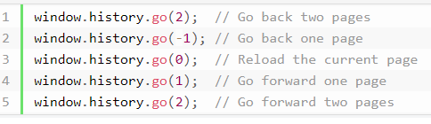
Going Back/Forward to the Previous Page
You can use the back() method of the History object i.e. history.back() to go back to the previous page in session history. It is same as clicking the browser's back button.
You can use the forward() method of the History object i.e. history.forward() to go forward to the next page in session history. It is same as clicking the browser's forward button.
You can also load specific page from the session history using the go() method of the History object i.e. history.go(). This method takes an integer as a parameter. A negative integer moves backward in the history, and a positive integer moves forward in the history.
<script>
function goBack() {
window.history.back();
}
</script>
<button type="button" onclick="goBack();">Go Back</button>
If you attempt to access the page that does not exist in the window's history then the methods
back(), forward() and go() will simply do nothing.

Slide 48
JavaScript Window Navigator
<!DOCTYPE html>
<html lang="en">
<head>
<meta charset="utf-8">
<title>JavaScript Detect If Browser is Online or Offline</title>
</head>
<body>
<script>
function checkConnectionStatus() {
if(navigator.onLine) {
alert("Application is online.");
} else {
alert("Application is offline.");
}
}
</script>
<button type="button" onclick="checkConnectionStatus();">Check Connection Status</button>
</body>
</html>
The navigator property of a window (i.e. window.navigator) is a reference to a Navigator object; it is a read-only property which contains information about the user's browser.
You can use the navigator.onLine property to detect whether the browser (or, application) is online or offline. This property returns a Boolean value true meaning online, or false meaning offline.

Slide 49
Browser fires online and offline events when a connection is establish or lost. You can attach handler functions to these events in order to customize your application for online and offline scenarios.
The goOffline() function in the above example will be called automatically by the browser whenever the connection goes offline, whereas the goOnline() function will be called automatically by the browser when the connection status changes to online.

Slide 50
Check Whether Cookies Are Enabled or Not
<script>
function checkCookieEnabled() { if(navigator.cookieEnabled) {
alert("Cookies are enabled in your browser.");
}
else
{ alert("Cookies are disabled in your browser.");
}
}
</script>
<button type="button" onclick="checkCookieEnabled();">Check If Cookies are Enabled
</button>
You can use the navigator.cookieEnabled to check whether cookies are enabled in the user's browser or not. This property returns a Boolean value true if cookies are enabled, or false if it isn't.
You should use the navigator.cookieEnabled property to determine whether the cookies are enabled or not before creating or using cookies in your JavaScript code.

Slide 51
Detecting the Browser Language
You can use the navigator.language property to detect the language of the browser UI.
This property returns a string representing the language, e.g. "en", "en-US", etc.
<script>
function checkLanguage() {
alert("Your browser's UI language is: " + navigator.language);
}
</script>
<button type="button" onclick="checkLanguage();">Check language</button>

Slide 52
Check Whether the Browser is Java Enabled or Not
<script>
function checkJavaEnabled() {
if(navigator.javaEnabled()) {
alert("Your browser is Java enabled.");
} else {
alert("Your browser is not Java enabled.");
}
}
</script>
<button type="button" onclick="checkJavaEnabled();">Check If Java is Enabled</button>
You can use the method javaEnabled() to check whether the current browser is Java-enabled or not.
This method simply indicates whether the preference that controls Java is on or off, it does not reveal whether the browser offers Java support or Java is installed on the user's system or not.

Slide 53
Getting Browser Name and Version Information
The Navigator object has five main properties that provide name and version information about the user's browser. The following list provides a brief overview of these properties:
appName — Returns the name of the browser. It always returns "Netscape", in any browser.
appVersion — Returns the version number and other information about the browser.
appCodeName — Returns the code name of the browser. It returns "Mozilla", for all browser.
userAgent — Returns the user agent string for the current browser. This property typically contains all the information in both appName and appVersion.
platform — Returns the platform on which browser is running (e.g. "Win32", "WebTV OS", etc.)
As you can see from the above descriptions, the value returned by these properties are misleading and unreliable, so don't use them to determine the user's browser type and version.

Slide 54
<script>
function getBrowserInformation() {
var info = "\n App Name: " + navigator.appName;
info += "\n App Version: " + navigator.appVersion;
info += "\n App Code Name: " + navigator.appCodeName;
info += "\n User Agent: " + navigator.userAgent;
info += "\n Platform: " + navigator.platform;
alert("Here're the information related to your browser: " + info);
}
</script>
<button type="button" onclick="getBrowserInformation();">Get Browser Information</button>

Slide 55
JavaScript Timers
<!DOCTYPE html>
<html lang="en">
<head>
<meta charset="utf-8">
<title>JavaScript Execute a Function after Some Time</title>
</head>
<body>
<script>
function myFunction() {
alert('Hello World!');
}
</script>
<button onclick="setTimeout(myFunction, 2000)">Click Me</button>
<p><strong>Note:</strong> Alert popup will be displayed 2 seconds after clicking the button.</p>
</body>
</html>
A timer is a function that enables us to execute a function at a particular time.
Using timers you can delay the execution of code so that it does not get done at the exact moment an event is triggered or the page is loaded.
For example, you can use timers to change the advertisement banners on your website at regular intervals, or display a real-time clock, etc.
The setTimeout() function is used to execute a function or specified piece of code just once after a certain period of time. Its basic syntax is setTimeout(function, milliseconds).
This function accepts two parameters: a function, which is the function to execute, and an optional delay parameter, which is the number of milliseconds representing the amount of time to wait before executing the function (1 second = 1000 milliseconds)

Slide 56
Executing Code at Regular Intervals
<!DOCTYPE html>
<html lang="en">
<head>
<meta charset="utf-8">
<title>JavaScript Execute a Function at Regular Intervals</title>
</head>
<body>
<script>
function showTime() {
var d = new Date();
document.getElementById("clock").innerHTML = d.toLocaleTimeString();
}
setInterval(showTime, 1000);
</script>
<p>The current time on your computer is: <span id="clock"></span></p>
</body>
</html>
Similarly, you can use the setInterval() function to execute a function or specified piece of code repeatedly at fixed time intervals. Its basic syntax is setInterval(function, milliseconds).
This function also accepts two parameters: a function, which is the function to execute, and interval, which is the number of milliseconds representing the amount of time to wait before executing the function (1 second = 1000 milliseconds).

Slide 57
Stopping Code Execution or Cancelling a Timer
Both setTimeout() and setInterval() method return an unique ID (a positive integer value, called timer identifier) which identifies the timer created by the these methods.
This ID can be used to disable or clear the timer and stop the execution of code beforehand. Clearing a timer can be done using two functions: clearTimeout() and clearInterval().
The setTimeout() function takes a single parameter, an ID, and clear a setTimeout() timer associated with that ID,

Slide 58
<script>
var intervalID;
function showTime() {
var d = new Date();
document.getElementById("clock").innerHTML = d.toLocaleTimeString();
}
function stopClock() {
clearInterval(intervalID);
}
var intervalID = setInterval(showTime, 1000);
</script>
<p>The current time on your computer is: <span id="clock"></span></p>
<button onclick="stopClock();">Stop Clock</button>
Similarly, the clearInterval() method is used to clear or disable a setInterval() timer.
You can technically use clearTimeout() and clearInterval() interchangeably. However, for clarity and code maintainability you should avoid doing so

Slide 59
JavaScript Cookies
Self study Cookies
https://www.w3schools.com/js/js_cookies.asp

